Slide 1

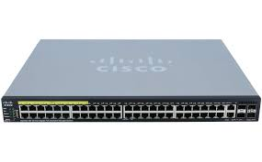
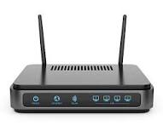
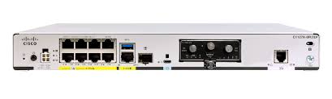


LAN DIAGRAM OF 19TH BN
SWITCHING OF 3RD FLOOR
MODEM
TELECOM DETT
ROUTER
SWITCHING OF 2ND FLOOR
PNR
INT
ACCTT BRANCH
OPS ROOM
OPS
QM BRANCH
ESTT BRANCH
SWITCHING OF 1ST FLOOR
APAR CELL
QUARTER MASTER
SECOND-IN-CMD
MAIN POE SWITCH
SWITCHING ON GROUND FLOOR
CONFERENCE HALL
ADJUTANT OFFICE
ENGR OFFICE
PA TO COMDT
COMMANDANT OFFICE
ITCELL
EDN BRANCH
MT
UNIT HOSPITAL
GD OFFICE
IT-CELL/SERVER ROOM ESTABLISHED AT GROUND FLOOR

Slide 2
DETAILS OF COMPUTER IN R/O 19TH BN
SN | MAKE | PROCESSOR | RAM | STORAGE | GRAPHIC CARD | VERSION OF OS | DATE OF PURCHASE | REMARKS
 | LENOVO | LENOVO V530 CORE i3 9100 8TH GEN | 4GB DDRA 4 RAM | 1 TB HDD | NIL | 10 PRO
 | LENOVO | LENOVO V530 CORE i3 9100 8TH GEN | 4GB DDRA 4 RAM | 1 TB HDD | NIL | 10 PRO
 | LENOVO | LENOVO V530 CORE i3 9100 8TH GEN | 4GB DDRA 4 RAM | 1 TB HDD | NIL | 10 PRO
 | LENOVO | LENOVO V530 CORE i3 9100 8TH GEN | 4GB DDRA 4 RAM | 1 TB HDD | NIL | 10 PRO

Slide 3
SN | MAKE | PROCESSOR | RAM | STORAGE | GRAPHIC CARD | VERSION OF OS | DATE OF PURCHASE | REMARKS
 | LENOVO
 | LENOVO
 | LENOVO
 | LENOVO
 | LENOVO
 | LENOVO
 | LENOVO
 | LENOVO
 | LENOVO
 | LENOVO

Slide 4
SN | MAKE | PROCESSOR | RAM | STORAGE | GRAPHIC CARD | VERSION OF OS | DATE OF PURCHASE | REMARKS
 | LENOVO
 | LENOVO
 | LENOVO
 | LENOVO
 | LENOVO
 | LENOVO
 | LENOVO
 | LENOVO
 | LENOVO
 | LENOVO

Slide 5
SN | MAKE | PROCESSOR | RAM | STORAGE | GRAPHIC CARD | VERSION OF OS | DATE OF PURCHASE | REMARKS
 | LENOVO
 | LENOVO
 | LENOVO
 | LENOVO
 | LENOVO
 | LENOVO
 | LENOVO
 | LENOVO
 | LENOVO
 | LENOVO

Slide 6
SN | MAKE | PROCESSOR | RAM | STORAGE | GRAPHIC CARD | VERSION OF OS | DATE OF PURCHASE | REMARKS
 | LENOVO
 | LENOVO
 | LENOVO
 | LENOVO
 | LENOVO
 | LENOVO
 | LENOVO
 | LENOVO
 | LENOVO
 | LENOVO

